Slide 1
Scheduling Pipelined Circuits
By Ravindu Athukorala

Slide 2


Motivation!
[1]
[2]

Slide 3
Introduction
Concept
Benefit in circuit design
Importance of efficient Scheduling

Slide 4
Overview Of Pipelining
Pipelining and its purpose
Breaking complex tasks into smaller stages
Advantages of pipelining

Slide 5
Various Scheduling Techniques
ASAP Scheduling
ALAP Scheduling
List Scheduling with ILP

Slide 6
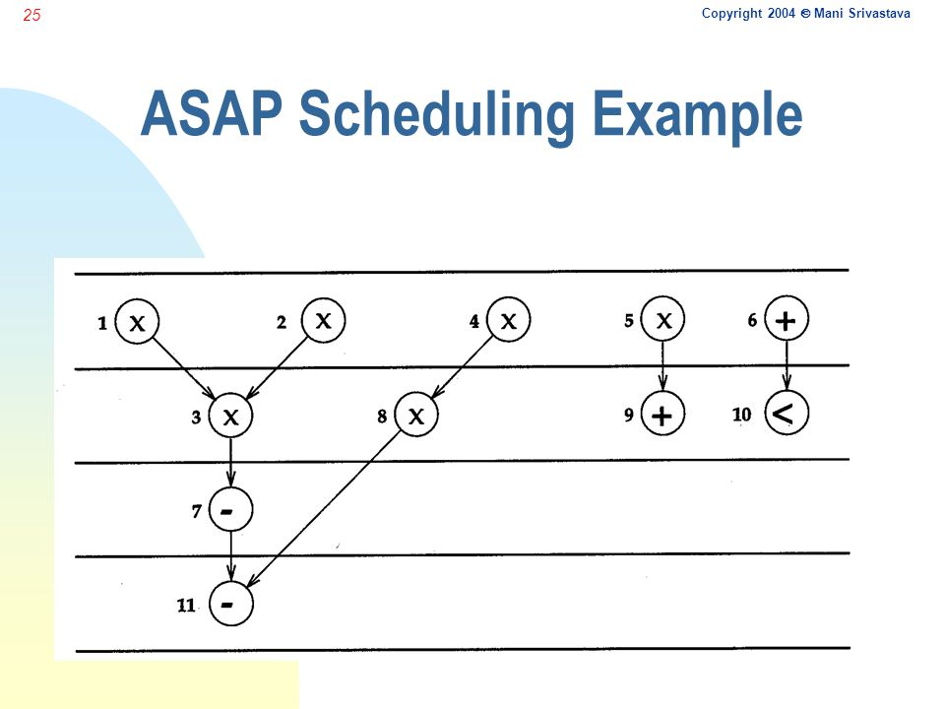
ASAP Scheduling
[3]

Slide 7
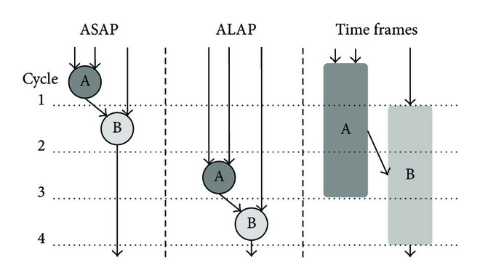
ALAP Scheduling
[4]

Slide 8
Scheduling Trade Offs
Performance vs resource utilization
Schedule length vs latency
Complexity and optimality

Slide 9
Tools/Software Support/Applications
Popular Scheduling Tools
Applications - Digital Signal Processing
Microprocessors
High Performance Computing
Network And Communication Systems

Slide 10
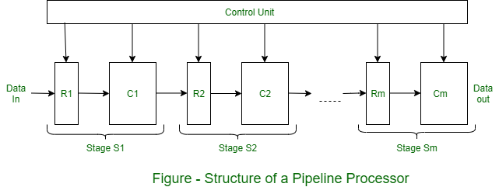
Conclusion
[5]

Slide 11
References
TechinPost, T. (2020) [guide] how do Analog & digital circuits shape the electronics industry?, TechinPost. Available at: https://www.techinpost.com/how-analog-digital-circuits-shape-electronics-industry/ (Accessed: 02 July 2023).
Zhao, H. (2021) A comprehensive guide to building digital circuits, WellPCB. Available at: https://www.wellpcb.com/digital-circuits.html (Accessed: 02 July 2023).
Scheduling for synthesis of embedded hardware - PPT video online download (no date) SlidePlayer. Available at: https://slideplayer.com/slide/5334946/ (Accessed: 02 July 2023).
Hindawi (no date) Figure 2: A high-level synthesis scheduling and binding heuristic for FPGA fault tolerance, Figure 2 | A High-Level Synthesis Scheduling and Binding Heuristic for FPGA Fault Tolerance. Available at: https://www.hindawi.com/journals/ijrc/2017/5419767/fig2/ (Accessed: 02 July 2023).
Pipelined architecture with its diagram (2020) GeeksforGeeks. Available at: https://www.geeksforgeeks.org/pipelined-architecture-with-its-diagram/.

